Slide 1

hgdcf
LAST-MILE DELIVERY OPERATION ANALYTICS
A DATABASE USING MYSQL
PRESENTED BY:
ANDHAVARAPU MADHUPRIYA

Slide 2
ABOUT ME
I’m A.Madhupriya,an aspiring Data Analyst with an interest in python,sql,data analysis.
I built a LAST-MILE DELIVERY OPERATION ANALYTICS project using MySQL to analyze delivery operational data and generate meaningful insights.
Work Experience : Fresher
LINKEDIN :https://www.linkedin.com/in/madhupriya-andhavarapu-8a5386421
GITHUB: https://github.com/andhavarapupriya03

Slide 3
AGENDA
Project Overview
Project Objective
ER Diagram & Database structure
SQL Analysis & Business Questions
Key Insights & Findings
Challenges Faced in the Project
Conclusion & Recommendations

Slide 4
Project Overview:
This project focuses on studying last-mile delivery operations using MySQL
It uses SQL to manage and analyze customers,orders,deliveries,drivers,and vehicles.
It helps the operations team analyze delivery demand, customer ordering behaviour, delivery performance and resource utilization.
It evaluates delivery zones, service types, priorities, delivery duration, delivery status, and order values to understand operational performance.
It analyzes driver performance and vehicle usage to understand how delivery resources are being used.
It identifies delivery problems, including multiple delivery attempts, common delivery statuses, and zones with higher delivery problems.
The analysis produces findings, business insights, conclusions, and recommendations to support operational decision-making.

Slide 5
Project Objective:
To understand the last-mile delivery business and its operations.
Analyze order and delivery activity across different delivery zones.
Compare customer ordering behaviour, service types, and order priorities.
Identify delivery performance, statuses, and multiple delivery attempts.
Compare driver performance and vehicle utilization across deliveries.
Analyze delivery duration, distance travelled, and package weight to identify operational patterns.
Identify meaningful business insights from delivery data to support operational decision-making.

Slide 6
Database Structure:
This project contains 5 interrelated tables:
Customers
Orders
Drivers
Vehicles
Deliveries
These tables are connected using Primary Keys and Foreign keys to maintain relational database integrity and ensure consistency across customers, orders, drivers, vehicles and deliveries.
The relationships between the tables help in analyzing customers order, delivery details, delivery performance, driver performance, vehicle utilization and delivery problem.

Slide 7
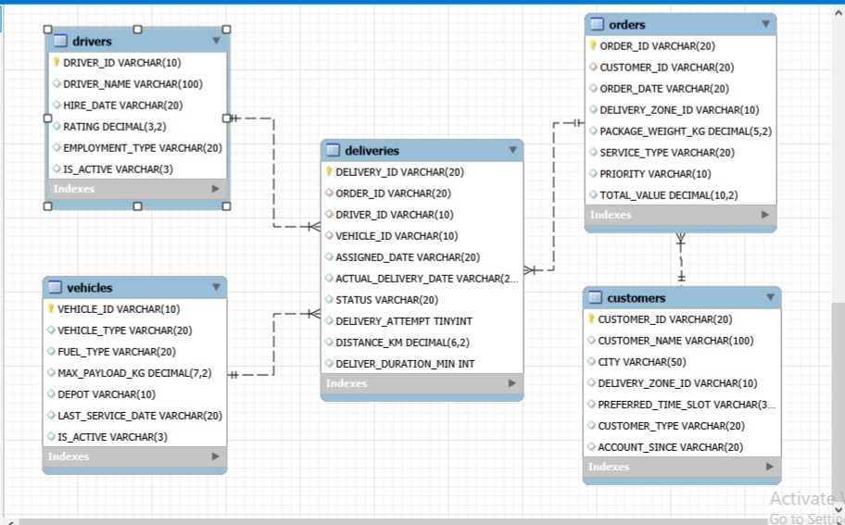
ER DIAGRAM:

Slide 8

Key Analysis Questions
What is the total number of customers?
SQL Query:
Output:
This query counts the total number of customers in the company.
It helps to measure the overall customers base.

Slide 9

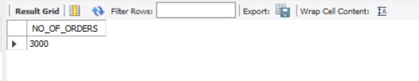
.
What is the total number of orders?
SQL Query:
Output:
This query counts the total number of orders.
It helps to understand the overall order volume.

Slide 10

What is the total number of deliveries?
SQL Query:
Output:
This query counts the total number of deliveries.
It helps to measure the overall delivery activity.

Slide 11

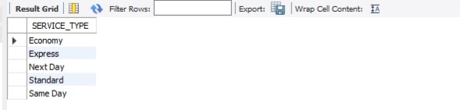
What are the different service type available?
SQL Query:
Output:
DISTINCT removes duplicates service types.
It helps the company understand the different delivery services offered.

Slide 12


How many drivers are currently active?
SQL Query:
Output:
COUNT(*) counts the drivers.
WHERE IS_ACTIVE=‘Yes’ selects only active drivers.
It helps the company understand the currently available driver workforce.

Slide 13

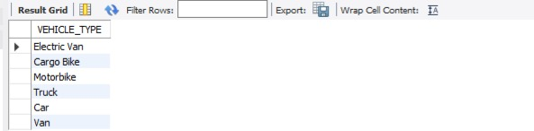
What are the different vehicle types?
SQL Query:
Output:
This query displays the unique vehicle types.
It helps understand the types of vehicles available in the delivery fleet.

Slide 14

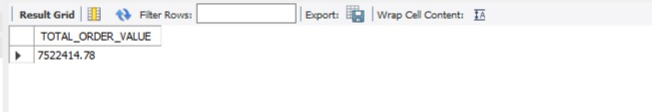
What is the total order value?
SQL Query:
Output:
SUM() adds the value of all orders.
It helps measure the total value generated from customer orders.

Slide 15


What is the average package weight?
SQL Query:
Output:
AVG() calculates the average package weight.
It helps understand the typical weight of package handled by the delivery operation.

Slide 16

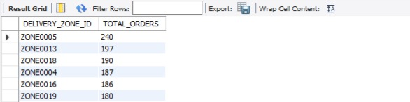
Which delivery zones have the highest number of orders?
SQL Query:
Output:
This query counts the numbers of orders generated in each delivery zone.
It helps identify high-demand delivery zones when more delivery resources may be required.

Slide 17

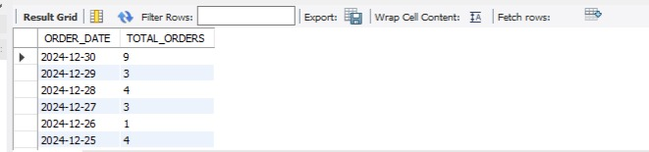
How does order volume change over time?
SQL Query:
Output:
This query counts the number of orders received on each date.
It helps identify changes and patterns in order demand over time.

Slide 18

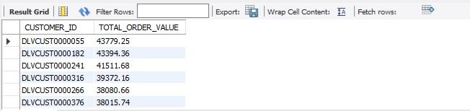
Which customers have highest total order value?
SQL Query:
Output:
This query calculates the total value of orders placed by each customer.
It helps identify customers who contribute higher order value to the business.

Slide 19
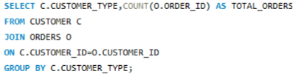
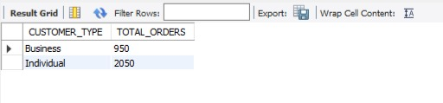
How does customer ordering activity differ between business and individual customers?
SQL Query:
Output:
This query connects customers with their orders using CUSTOMER_ID.
It compares the number of orders placed by business and individual customers.

Slide 20

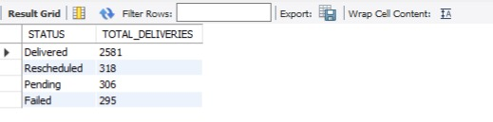
What are the different delivery statuses and how many deliveries have each status?
SQL Query:
Output:
This query counts deliveries according to their status.
It helps identify the most common delivery outcomes such as delivered, failed, pending or rescheduled.

Slide 21
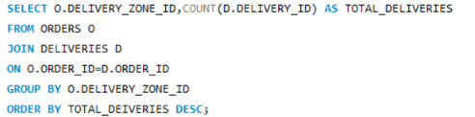
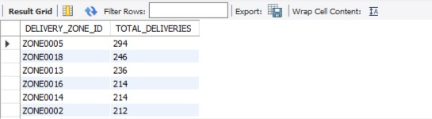
Which delivery zone have highest delivery activity?
SQL Query:
Output:
This query connects orders and deliveries using ORDER_ID.
It helps identify high-activity delivery zones.

Slide 22
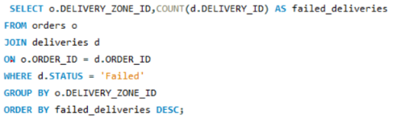
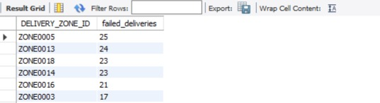
Which delivery zones have more failed deliveries?
SQL Query:
Output:
This query identifies failed deliveries in each delivery zone.
It helps the operations team identify zones with poorer delivery outcomes.

Slide 23
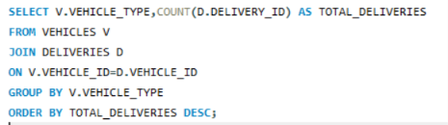
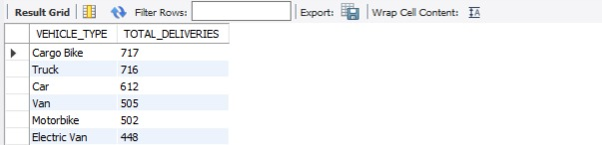
How many deliveries were handled by each vehicle type?
SQL Query:
Output:
This queries connects vehicles with their deliveries.
It helps identify which vehicle types are used most frequently.

Slide 24
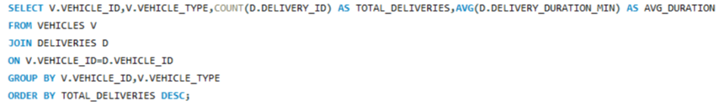
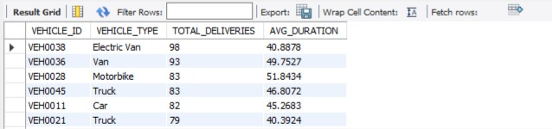
What is the delivery performance of each vehicle?
SQL Query:
Output:
Compares the number of deliveries and average delivery time for each vehicle.
Helps evaluate vehicle utilization and delivery efficiency.

Slide 25

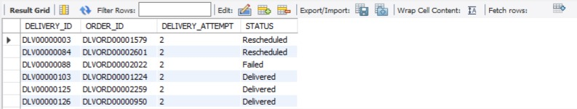
Which deliveries required multiple attempts?
SQL Query:
Output:
Identifies deliveries that needed multiple attemts.
Helps analyze problematic delivery cases.

Slide 26
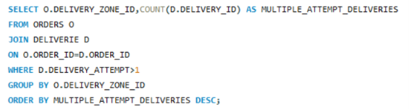
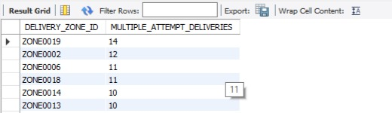
Which delivery zones have the most multiple-attempt deliveries?
SQL Query:
Output:
Identifies zones with more multiple-attempt deliveries.
Helps locate areas with higher delivery problems.

Slide 27
KEY INSIGHTS & FINDINGS
Analyzed delivery demand across zones, services, and priorities.
Identified customer ordering and order-value patterns.
Evaluated delivery performance and delivery outcomes.
Compared driver workload and vehicle utilization.
Identified multiple-attempt and failed deliveries.
Highlighted areas requiring operational improvement.

Slide 28
CHALLENGES/EXPERIENCES
Challenges:
Understanding ER diagram and table relationships.
Converting business problems into SQL queries.
Handling JOINs and aggregate functions.
Analyzing large datasets and interpreting results.
Experiences:
Gained practical MySQL experience.
Improved SQL and analytical skills.
Learned to derive business insights from data.
Developed better problem-solving and decision-making skills.

Slide 29
CONCLUSION
Successfully developed a relational last-mile delivery database using interconnected tables.
Gained practical knowledge of Primary Keys and Foreign Keys.
Gained experience in delivery data analysis and data interpretation.
Learned to analyze delivery data using GROUP BY, Subqueries, CASE statements, and aggregate functions.
Improved skills in writing JOIN and aggregate SQL queries.
Gained practical experience in analyzing delivery demand, customer behaviour, delivery performance, and resource utilization.
Overall, this project helped strengthen MySQL, database management, data analysis, and analytical thinking skills.

Slide 30

THANK YOU

